Slide 1
Building a Datapath

Slide 2
DATAPATH ELEMENT
A unit used to operate on or hold data within a processor. In the MIPS implementation, the datapath elements include the instruction and data memories, the register file, the ALU, and adders.

Slide 3
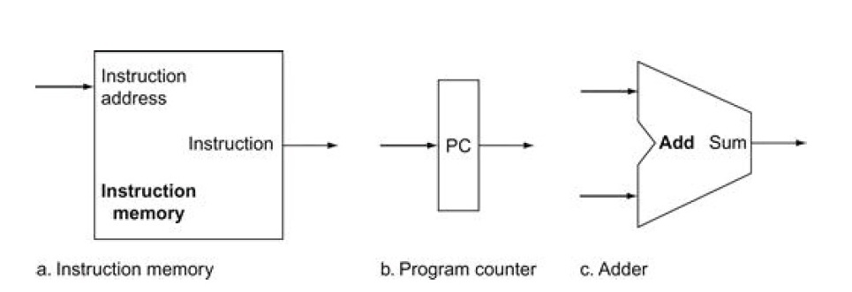
Two state elements are needed to store and access instructions, and an adder is needed to compute the next instruction address.

Slide 4
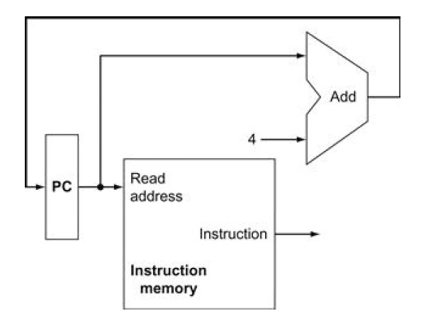
A portion of the datapath used for fetching instructions and incrementing the program counter.
The fetched instruction is used by other parts of the datapath.

Slide 5
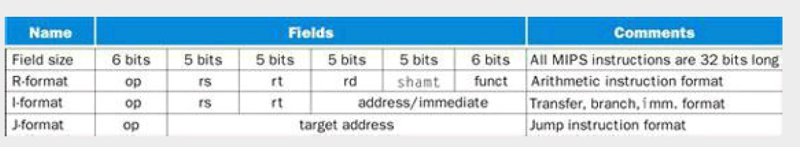

Slide 6
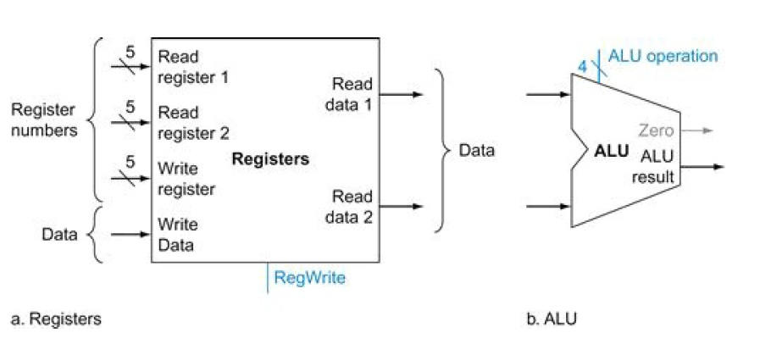

Slide 7
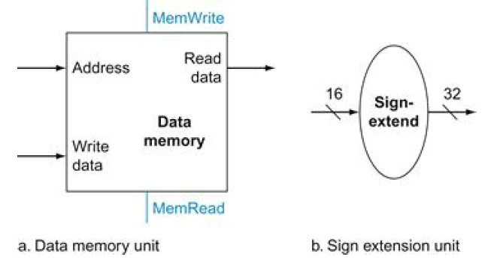
The two units needed to implement loads and stores, in addition to the register file and ALU of Figure
4.7, are the data memory unit and the sign extension unit.

Slide 8
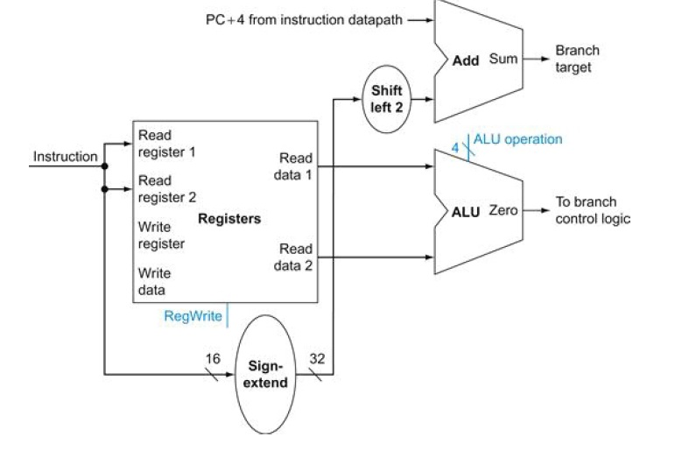

Slide 9
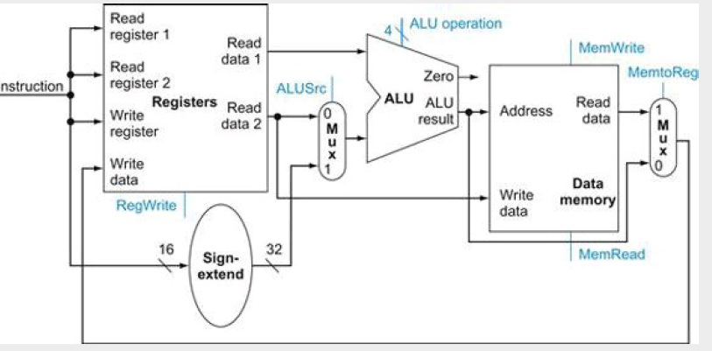

Slide 10
